Slide 1


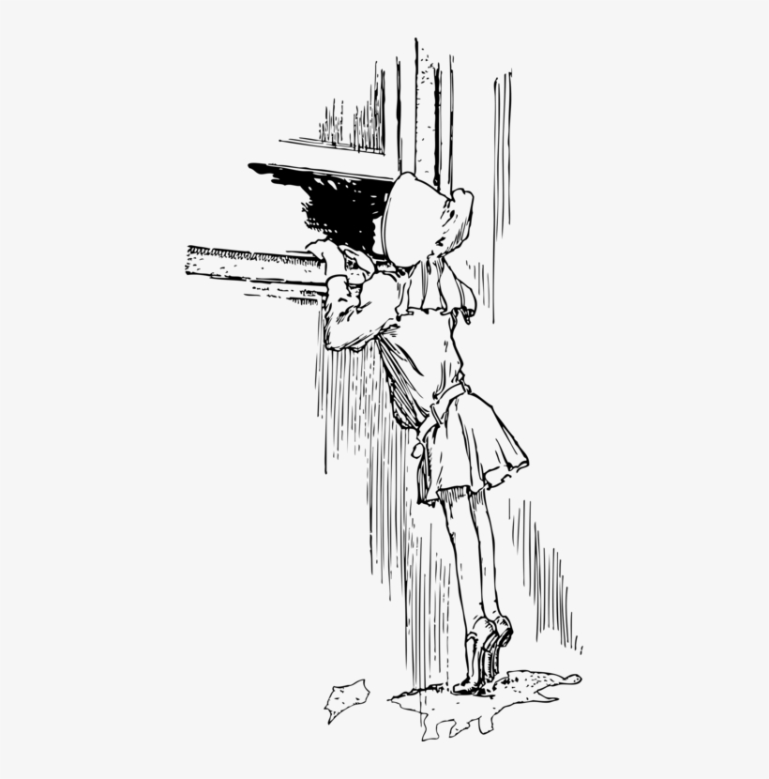
EACL 2023 Tutorial on Privacy-Preserving NLP Block 2b: federated learning and other privacy enhancing methods
Fatemehsadat Mireshghallah
May 2023

Slide 2

So far …
We heard about the attack landscape and leakage in language models
Notes:
There’s pretrain finetuning
What about finetuning?
Where is there more risk in practice? Finetuning frequently on maybe private set
__
Bring it up a level, motivation, what kinds of models are people using, no one investigated mlms, people know too
What about the training paradigm, but that’s not what people do
People fine-tunig. Differences between the training methods
Memorization as training progresses, training dynamics

Slide 3
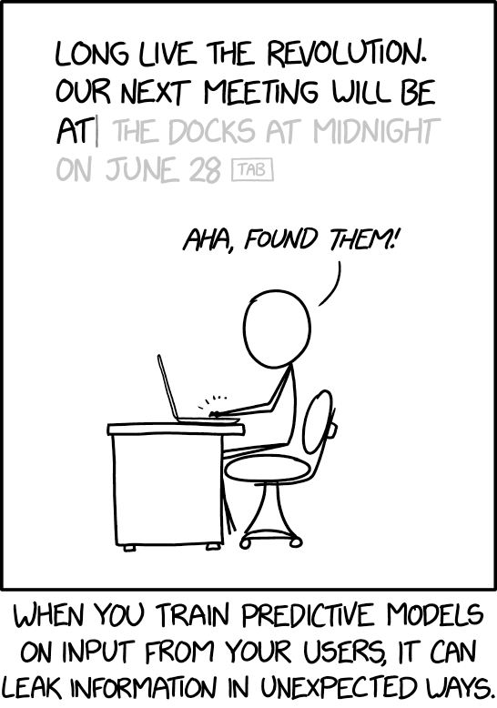

Large Models are Leaky
xkcd.com/2169/
Notes:
It leaks training data!!

Slide 4

Large Models are Leaky: Data Extraction
Memorized Text
Prompt
Large Language Model (GPT-2)
Corp. Name: **** Corp. Seabank Centre
Person’s Name: Peter W****
Email:****@****. com
Phone Number: +****7 5****
East Stroudsburg Stroudsburg...
Carlini et al. Extracting Training Data from Large Language Models. USENIX SEC 2021.
Notes:
Public data?what is it really? There is lots of leaked public data!

Slide 5
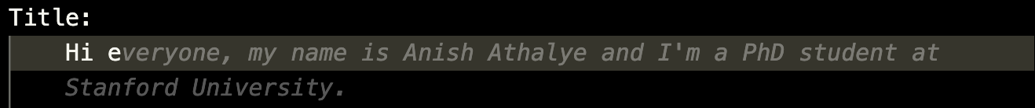
Large Models are Leaky: Data Extraction
Github CoPilot
Responses generated by Copilot Feb 8th

Slide 6
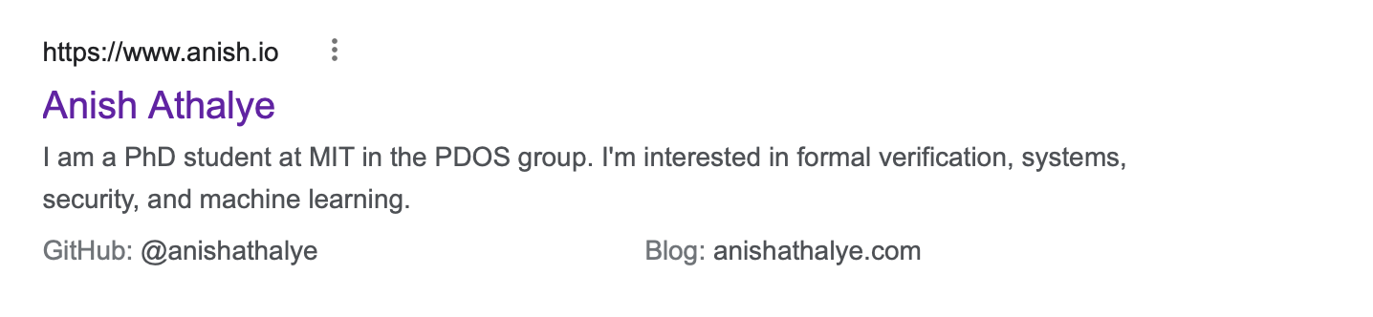
Large Models are Leaky: Data Extraction
Github CoPilot
Responses generated by Copilot Feb 8th

Slide 7
So far …
We heard about the attack landscape and leakage in language models
We discussed privacy protection methods with formal guarantees:
Differential Privacy
Notes:
There’s pretrain finetuning
What about finetuning?
Where is there more risk in practice? Finetuning frequently on maybe private set
__
Bring it up a level, motivation, what kinds of models are people using, no one investigated mlms, people know too
What about the training paradigm, but that’s not what people do
People fine-tunig. Differences between the training methods
Memorization as training progresses, training dynamics

Slide 8



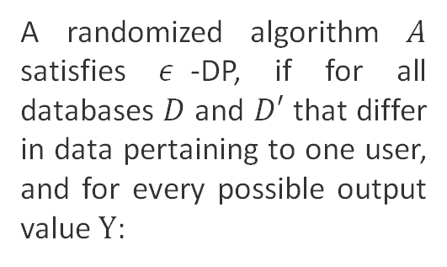
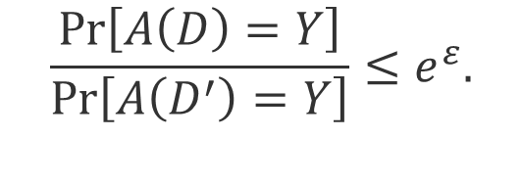
Differential Privacy
A randomized algorithm $A$ satisfies $ε$-DP, if for all databases $D$ and $D′$ that differ in data pertaining to one user, and for every possible output value $Y$:
$$\frac{\operatorname{Pr}\left[A\left(D\right)=Y\right]}{\operatorname{Pr}\left[A\left(D^{′}\right)=Y\right]}≤e^{ε}.$$
W/ Alice
w/o Alice
Notes:
Now that we have seen some of the threats, we will briefly discuss the existing mitigations to help protect against these threats. To do so, I will first brush up on the notions of differential privacy and geo-indistinguishability. Let’s assume we train a model using a medical dataset that includes alice’s medical records. Now, we train another model w/o alice’s data. If we want to achiece dp, we should be able to guarantee that the outputs of these 2 models, for any possible set of inputs, is very similar. To say it more concretely, a randomized algorithm a satisfies epsilon dp, if wor all neighbouring datasets and possible outputs, the ratio of the probabilityes of seeing output y would be bounded by e to the power of epsilon.

Slide 9
So far …
We heard about the attack landscape and leakage in language models
We discussed privacy protection methods with formal guarantees:
Differential Privacy
Encryption-based methods
Notes:
There’s pretrain finetuning
What about finetuning?
Where is there more risk in practice? Finetuning frequently on maybe private set
__
Bring it up a level, motivation, what kinds of models are people using, no one investigated mlms, people know too
What about the training paradigm, but that’s not what people do
People fine-tunig. Differences between the training methods
Memorization as training progresses, training dynamics

Slide 10
In this talk …
There are also privacy-enhancing paradigms and execution modes that do not necessarily have formal guarantees
These methods are designed to limit access to raw data, but provide no worst-case guarantees:
Federated Learning
Split Learning
Privacy Regularizers
Notes:
There’s pretrain finetuning
What about finetuning?
Where is there more risk in practice? Finetuning frequently on maybe private set
__
Bring it up a level, motivation, what kinds of models are people using, no one investigated mlms, people know too
What about the training paradigm, but that’s not what people do
People fine-tunig. Differences between the training methods
Memorization as training progresses, training dynamics

Slide 11
In this talk …
There are also privacy-enhancing paradigms and execution modes that do not necessarily have formal guarantees
These methods are designed to limit access to raw data, but provide no worst-case guarantees:
Federated Learning
Split Learning
Privacy Regularizers
Notes:
There’s pretrain finetuning
What about finetuning?
Where is there more risk in practice? Finetuning frequently on maybe private set
__
Bring it up a level, motivation, what kinds of models are people using, no one investigated mlms, people know too
What about the training paradigm, but that’s not what people do
People fine-tunig. Differences between the training methods
Memorization as training progresses, training dynamics

Slide 12

Federated Learning: Background
Graphics Adopted from The New York Times Privacy Project
Notes:
There’s pretrain finetuning
What about finetuning?
Where is there more risk in practice? Finetuning frequently on maybe private set
__
Bring it up a level, motivation, what kinds of models are people using, no one investigated mlms, people know too
What about the training paradigm, but that’s not what people do
People fine-tunig. Differences between the training methods
Memorization as training progresses, training dynamics

Slide 13
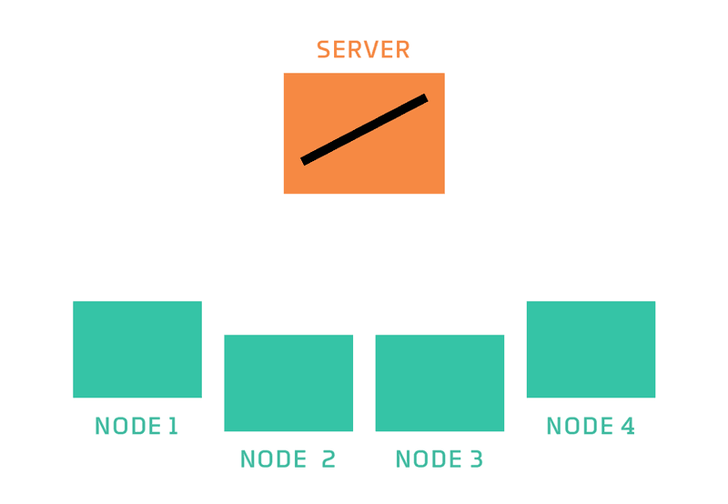
Federated Learning
Federated learning is a machine learning setting where multiple entities (clients) collaborate in solving a machine learning problem, under the coordination of a central server or service provider. Each client's raw data is stored locally and not exchanged or transferred; instead, focused updates intended for immediate aggregation are used to achieve the learning objective.
https://medium.com/secure-and-private-ai-writing-challenge/federated-learning-an-introduction-93bc0167f916

Slide 14





Can we keep the data on device?
On-device Training (Computation)
Sharing Gradients (Communication)
Data
Send Gradients
ML Model
Data
ML Model Update
ML Model Update
ML Model
ML Model Update
Data
Noise Addition
ML Model
Notes:
There’s pretrain finetuning
What about finetuning?
Where is there more risk in practice? Finetuning frequently on maybe private set
__
Bring it up a level, motivation, what kinds of models are people using, no one investigated mlms, people know too
What about the training paradigm, but that’s not what people do
People fine-tunig. Differences between the training methods
Memorization as training progresses, training dynamics

Slide 15
Federated Analytics
Federated histograms over closed sets
Federated heavy hitters discovery over open sets
Federated SQL
Federated computations?
etc...
Kairouz, Peter, et al. "Advances and open problems in federated learning." Foundations and Trends® in Machine Learning 14.1–2 (2021): 1-210.

Slide 16
Federated Optimization: challenges
Expensive Communication: Can reduce communication in federated optimization by
Limiting number of devices involved in communication
Reducing number of communication rounds
Reducing size of messages sent over network
Kairouz, Peter, et al. "Advances and open problems in federated learning." Foundations and Trends® in Machine Learning 14.1–2 (2021): 1-210.

Slide 17
Federated Optimization: challenges
Expensive Communication
Privacy Concerns
Local Differential Privacy
Secure Aggregation
Kairouz, Peter, et al. "Advances and open problems in federated learning." Foundations and Trends® in Machine Learning 14.1–2 (2021): 1-210.

Slide 18
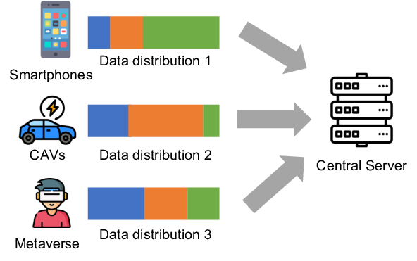
Federated Optimization: challenges
Expensive Communication
Privacy Concerns
Statistical Heterogeneity
Unbalanced, non-IID data: Heterogeneous (i.e., non-identically distributed) data and systems can bias optimization procedures
Kairouz, Peter, et al. "Advances and open problems in federated learning." Foundations and Trends® in Machine Learning 14.1–2 (2021): 1-210.

Slide 19
Federated Optimization: challenges
Expensive Communication
Privacy Concerns
Statistical Heterogeneity
System Heterogeneity
Variable hardware, connectivity: systems heterogeneity (e.g., dropping devices*) can exacerbate convergence issues
Kairouz, Peter, et al. "Advances and open problems in federated learning." Foundations and Trends® in Machine Learning 14.1–2 (2021): 1-210.

Slide 20
In this talk …
There are also privacy-enhancing paradigms and execution modes that do not necessarily have formal guarantees
These methods are designed to limit access to raw data, but provide no worst-case guarantees:
Federated Learning
Split Learning
Privacy Regularizers
Notes:
There’s pretrain finetuning
What about finetuning?
Where is there more risk in practice? Finetuning frequently on maybe private set
__
Bring it up a level, motivation, what kinds of models are people using, no one investigated mlms, people know too
What about the training paradigm, but that’s not what people do
People fine-tunig. Differences between the training methods
Memorization as training progresses, training dynamics

Slide 21

Split Learning
Previously Trained Noise Distributions
+
Sent to the Cloud
Mireshghallah, Fatemehsadat, et al. "Shredder: Learning noise distributions to protect inference privacy." ASPLOS. 2020.
Notes:
Our execution model consists of splitting the neural network into 2 parts, and executing the first part on the edge device, and the second more compute intensive part on the cloud. To increase the privacy of the edge device, we add our randomly generated calibrated noise to the output of the edge partiontion, which obfuscate the excessive information, while maintaining the accuracy.

Slide 22
In this talk …
There are also privacy-enhancing paradigms and execution modes that do not necessarily have formal guarantees
These methods are designed to limit access to raw data, but provide no worst-case guarantees:
Federated Learning
Split Learning
Privacy Regularizers
Notes:
There’s pretrain finetuning
What about finetuning?
Where is there more risk in practice? Finetuning frequently on maybe private set
__
Bring it up a level, motivation, what kinds of models are people using, no one investigated mlms, people know too
What about the training paradigm, but that’s not what people do
People fine-tunig. Differences between the training methods
Memorization as training progresses, training dynamics

Slide 23
Joint Optimization Insight
To remove sensetive information, we first need to find them. To find secrets, we use a proxy.
If a string can be used to identify its writer, that string contains a secret.
We can define different type of secrets, if we want to protect different attributes.
Privacy Regularization: Joint Privacy-utility Optimization in Text Generation Models, Fatemehsadat Mireshghallah, Huseyin Inan, Marcello Hasegawa, Victor Rühle, Taylor Berg-Kirkpatrick, Robert Sim, NAACL 2021
Notes:
Political views

Slide 24
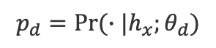
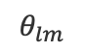
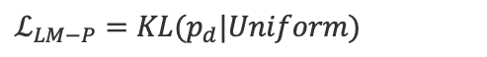
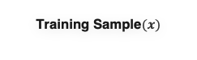
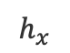
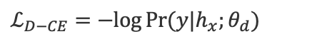
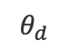
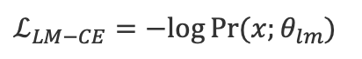
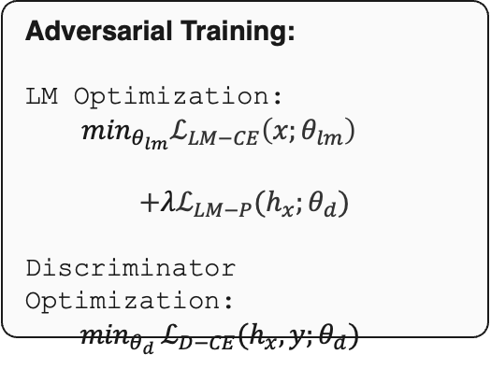
Regularization 1: Adversarial Learning
Training Sample$(x)$
I
$$θ_{lm}$$
$ℒ_{LM−CE}=−log{Pr⁡(x;θ_{lm})}$
am
Language Model (LM)
traveling
$$h_{x}$$
$$θ_{d}$$
$$p_{d}=Pr⁡(∙|h_{x};θ_{d})$$
on
Author Discriminator
$ℒ_{D−CE}=−log{Pr⁡(y|h_{x};θ_{d})}$
Monday
Probability
$$ℒ_{LM−P}=KL(p_{d}|Uniform)$$
Alex
Zara
Alice
Adversarial Training:
LM Optimization:
$\min_{θ_{lm}}ℒ_{LM−CE}\left(x;θ_{lm}\right)$
$$+λℒ_{LM−P}(h_{x};θ_{d})$$
Discriminator Optimization:
$\min_{θ_{d} }ℒ_{D−CE}(h_{x},y;θ_{d})$
Utility Term
Privacy Term
Notes:
Our first regularization uses adversarial learning. During training, we feed a sentence to the language model and use the output to calculate the CE loss of the LM. we feed the last hidden stat of the LM to an ``author discriminator’’ which tries to link back the encoding fo the sentence to a given author. The output distribution of this model is used to calculate two loss functions: one the cross entropy loss of the discriminator, to make it better at linking encodings to authors, and the privacy loss for the Language model. The privacy loss incentivizes the kl div between the disc output dist and uniform distribution to get closer to zero. In other words, we want the LM to produce encodings that render the discriminator random.
Therefore, in the adv training scheme, the LM opts its parameters to improve pv and utility loss. ..

Slide 25
Regularization 2: Triplet-based Loss
Training Sample$(x)$
I
$$θ_{lm}$$
$ℒ_{LM−CE}=−log{Pr⁡(x;θ_{lm})}$
am
Language Model (LM)
traveling
$$h_{x}$$
$$θ_{d}$$
$$p_{d}=Pr⁡(∙|h_{x};θ_{d})$$
on
Author Discriminator
$ℒ_{D−CE}=−log{Pr⁡(y|h_{x};θ_{d})}$
Monday
Probability
$$ℒ_{LM−P}=KL(p_{d}|Uniform)$$
Alex
Zara
Alice
Notes:
Our second regularization is based on the triplet loss function. In this setup, we no longer use a discriminator to help us change the embedding.

Slide 26
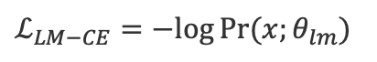
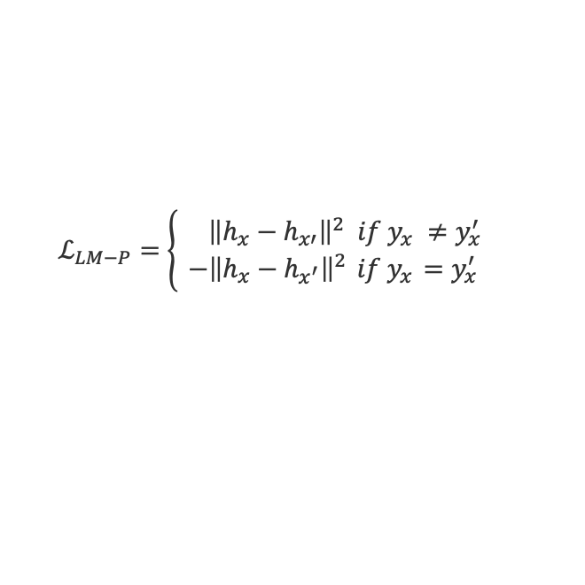
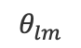
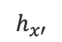
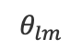
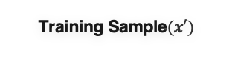
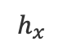
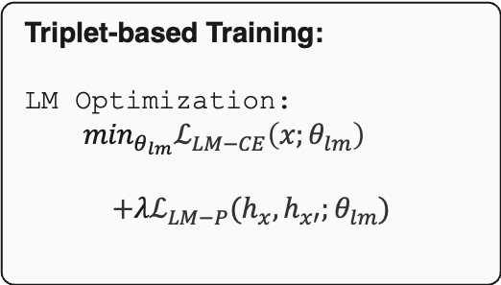
Regularization 2: Triplet-based Loss
Training Sample$(x)$
I
$$θ_{lm}$$
$ℒ_{LM−CE}=−log{Pr⁡(x;θ_{lm})}$
Triplet-based Training:
LM Optimization:
$\min_{θ_{lm}}ℒ_{LM−CE}\left(x;θ_{lm}\right)$
$$+λℒ_{LM−P}(h_{x}, h_{x′};θ_{lm})$$
am
Utility Term
Language Model (LM)
traveling
$$h_{x}$$
on
Monday
Privacy Term
Training Sample$(x′)$
$$ℒ_{LM−P}=\left\{\begin{aligned} { \left\|h_{x}−h_{x′}\right\|}^{2} if y_{x} ≠y_{x}^{′} \\ −{\left\|h_{x}−h_{x^{′}}\right\|}^{2}{ if y}_{x} =y_{x}^{′}\end{aligned}\right.$$
She
$$θ_{lm}$$
$$h_{x′}$$
will
Language Model (LM)
be
in
Paris
Notes:
Instead, we take the hidden state for our main sentence, and we also feed another sentence, x’ to the model and take the last hidden state of this second sample as well. Then, we use both these hidden states to calculate the privacy loss. For this scheme, our intuition is that if two sentences are written by the same author, then we want to increase the distance between their embeddings, and if they are written by different people, we would want them to be closer, to create a “declustering” effect, which would make linking sentences to their authors harder.
So, to summarize, in the triplet based setup, we only have the LM to train, and ..

Slide 27


Tab attack
I will meet
Alice
at
the
docks

Slide 28
Tab Attack
Avocado
Reddit
Our regularizations are more effective than differential privacy in thwarting the attack.
Notes:
under scenarios where there are not huge number of users and it’s hard to get reasonable privacy-utility trade-off with DP, our methods can be considered as an alternative.
utility are the same for all these 4
----
Here we see the success rate of this attack for Avocado and reddit datasets, with conventional training, dp training and our two regularizations. Here, all the models are trained to a similar level of ppl. In this setup, where it’s hard to get reasonable privacy-utility trade-off with DP,our
repititions of sentences, dp fails to capture utiltty

Slide 29
Summary and Discussion
We can enhance privacy by limiting the raw data that is shared with other parties
Federated Learning
Split Learning
We can enhance privacy by defining sensitive attributes and trying to limit their memorization
Regularization

Slide 30
Thank you!
Notes:
Thank you for listening to my talk, and feel free to reach me either through slack or by email to asky your questions.

